Slide 1


Foundations of
Scientific Computing
Dave Biersach
dbiersach@bnl.gov
Session 04
Computational
Mathematics

Slide 2
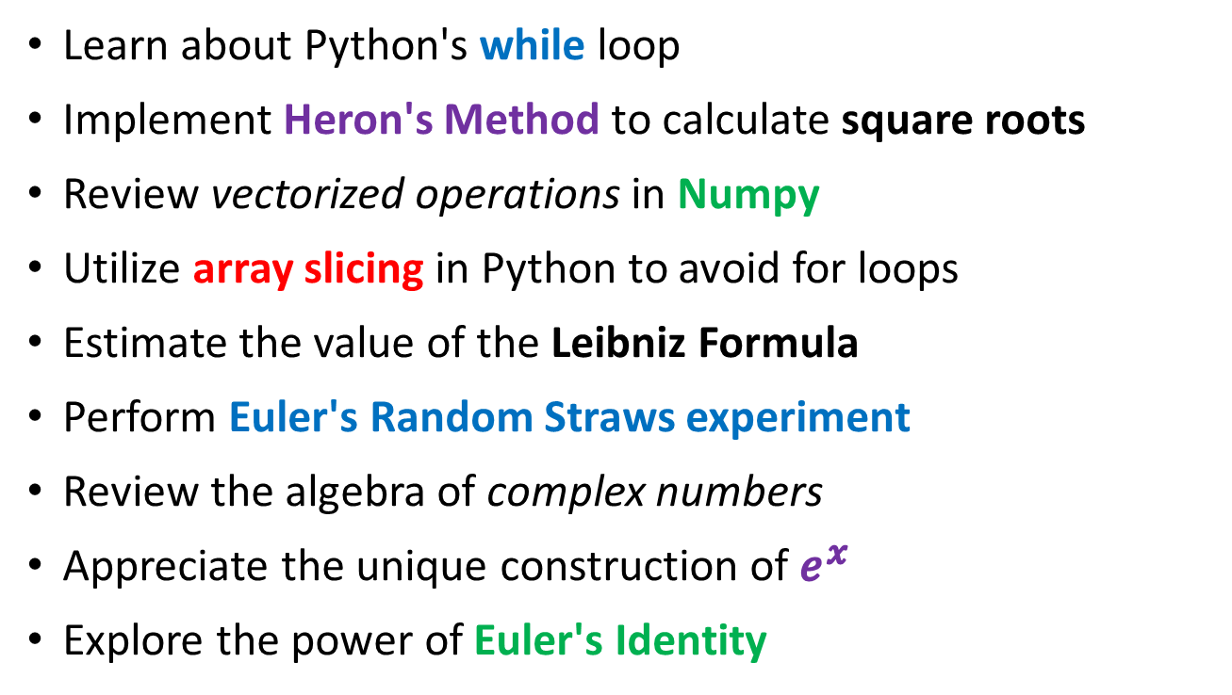
Session 04 – Goals
Learn about Python's while loop
Implement Heron's Method to calculate square roots
Review vectorized operations in Numpy
Utilize array slicing in Python to avoid for loops
Estimate the value of the Leibniz Formula
Perform Euler's Random Straws experiment
Review the algebra of complex numbers
Appreciate the unique construction of $e^{x}$
Explore the power of Euler's Identity

Slide 3
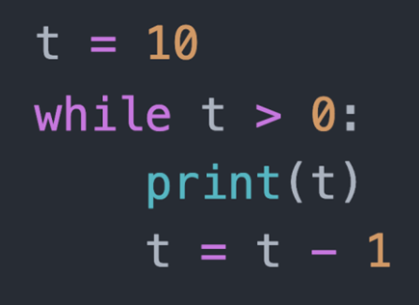
while Loop
A while loop executes all the statements within its scope as long as the loop conditional remains True
The loop conditional
A while loop introduces a scope

Slide 4
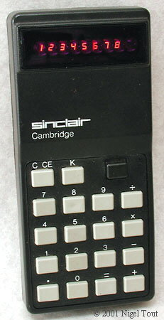
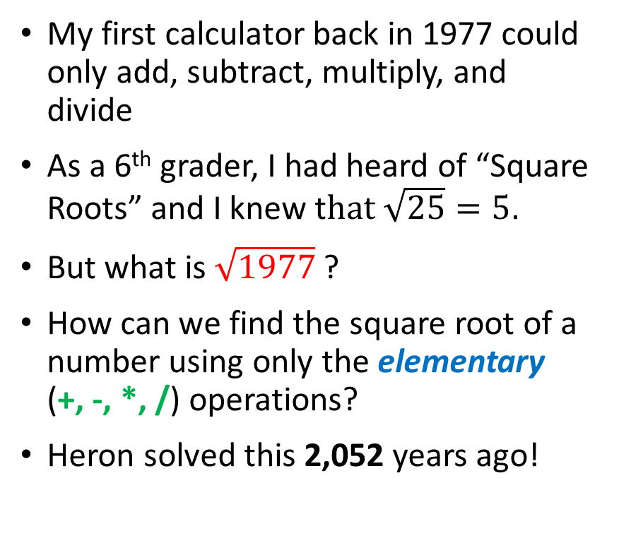
Old School Square Roots
My first calculator back in 1977 could only add, subtract, multiply, and divide
As a 6th grader, I had heard of “Square Roots” and I knew t$hat \sqrt{25}=5$.
But what is $\sqrt{1977}$ ?
How can we find the square root of a number using only the elementary (+, -, *, /) operations?
Heron solved this 2,052 years ago!

Slide 5
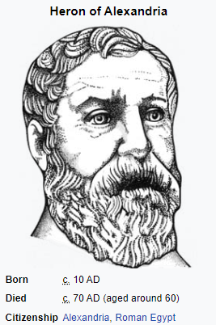
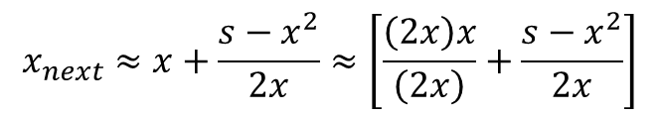
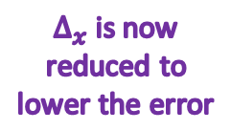


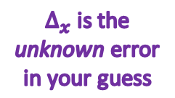


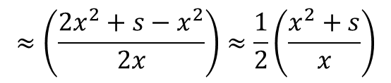
Estimating $\sqrt{s}$ using Heron's Method
$$x=initial guess of \sqrt{s}=s/2$$
$Δ_{x}$ is the unknown error in your guess
$$s={(x+∆_{x})}^{2}=x^{2}+\left(2x\right)∆_{x}+∆_{x}^{2}$$
$$∆_{x}=\frac{s−x^{2}}{2x+∆_{x}}$$
$Δ_{x}$ is now reduced to lower the error
$${Assume ∆}_{x}≪x∴∆_{x}≈\frac{s−x^{2}}{2x}$$
$$x_{next}=x+∆_{x}$$
$$x_{next}≈x+\frac{s−x^{2}}{2x}≈\left[\frac{\left(2x\right)x}{\left(2x\right)}+\frac{s−x^{2}}{2x}\right]$$
$$≈\left(\frac{{2x}^{2}+s−x^{2}}{2x}\right)≈\frac{1}{2}\left(\frac{x^{2}+s}{x}\right)$$
$$x_{next}≈Mean\left(x,\frac{s}{x}\right)$$

Slide 6
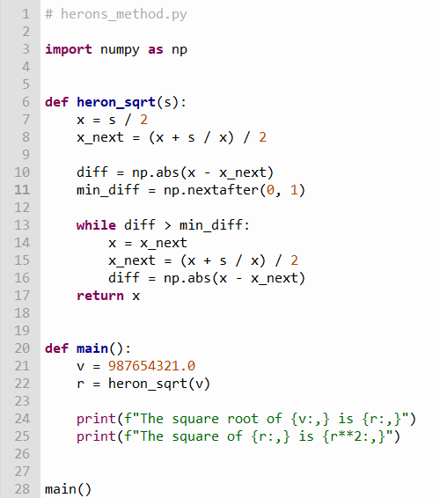
Edit herons_method.py
①
②
③
④
⑤
⑥
⑦
⑧
⑨
⑩

Slide 7
Edit herons_method.py
Type this code into your Thonny IDE

Slide 8
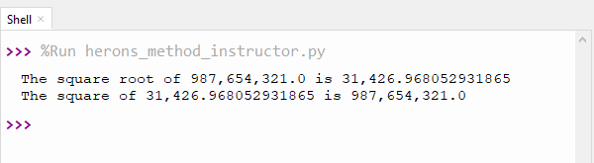


Run herons_method.py
$$x_{next}≈Mean\left(x,\frac{s}{x}\right)$$

Slide 9
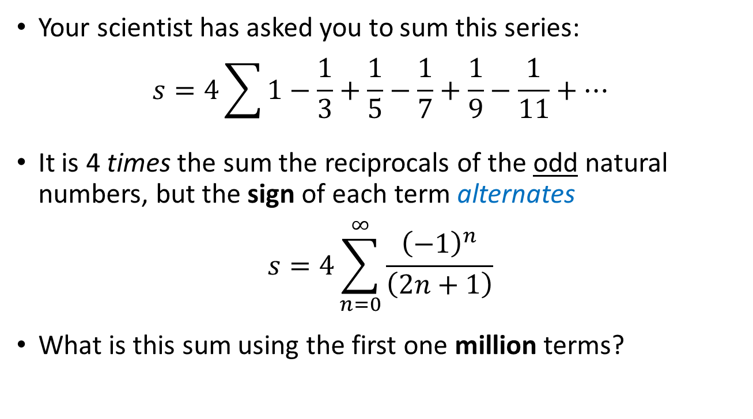
Another Surprising Series…
Your scientist has asked you to sum this series:
$$s=4\sum{1−\frac{1}{3}+\frac{1}{5}−\frac{1}{7}+\frac{1}{9}−\frac{1}{11}+⋯}$$
It is 4 times the sum the reciprocals of the odd natural numbers, but the sign of each term alternates
$$s=4\sum_{n=0}^{∞}{\frac{{\left(−1\right)}^{n}}{\left(2n+1\right)}}$$
What is this sum using the first one million terms?

Slide 10
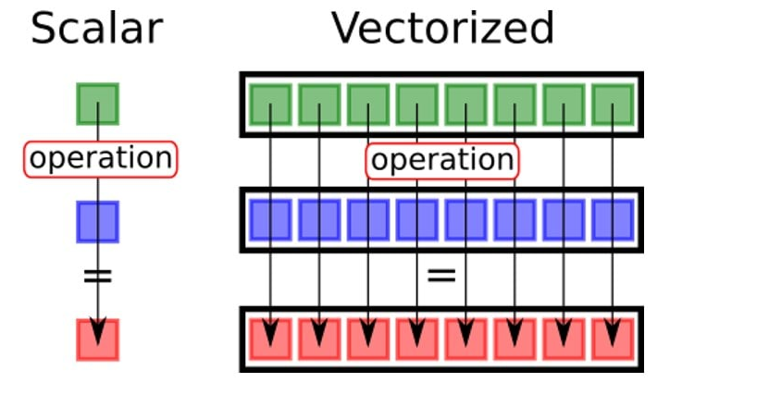
Numpy Vectorized Operations

Slide 11
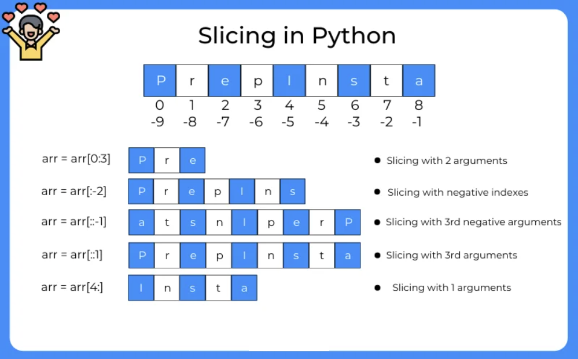

Slide 12
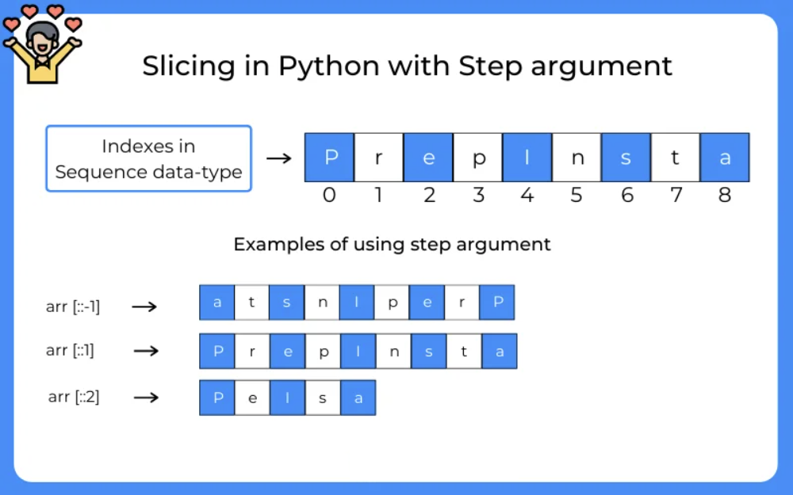

Slide 13
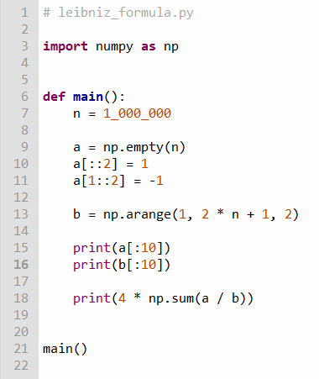


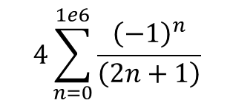
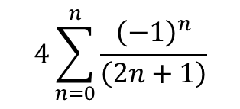





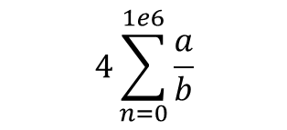

Edit leibniz_formula.py
$$4\sum_{n=0}^{n}{\frac{{\left(−1\right)}^{n}}{\left(2n+1\right)}}$$
$$n=1,000,000$$
①
$$4\sum_{n=0}^{1e6}{\frac{{\left(−1\right)}^{n}}{\left(2n+1\right)}}$$
inclusive
②
③
[start:stop:step]
④
exclusive
$$4\sum_{n=0}^{1e6}{\frac{a}{b}}$$
⑤
⑥
$${\left(−1\right)}^{0}=1$$
$${\left(−1\right)}^{1}=−1$$
$$a={(−1)}^{n}$$
⑦
$${\left(−1\right)}^{2}=1$$
$$b=(2n+1)$$
$${\left(−1\right)}^{3}=−1$$
$${\left(−1\right)}^{4}=1$$

Slide 14
Edit leibniz_formula.py
Type this code into your Thonny IDE

Slide 15
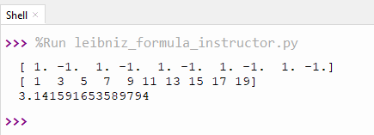
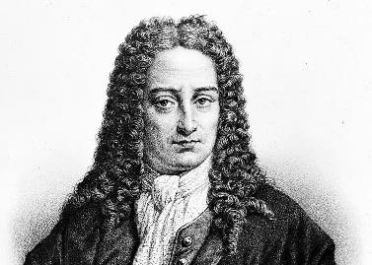
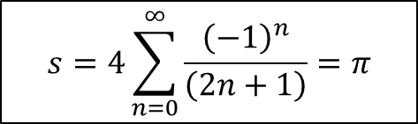
Run leibniz_formula.py
$$s=4\sum_{n=0}^{∞}{\frac{{\left(−1\right)}^{n}}{\left(2n+1\right)}}=π$$
Gottfried Wilhelm Leibniz
(1646 – 1716)

Slide 16

Random Straws
Write a program to perform ten million runs of an experiment that places a varying number of straws end-to-end each run
In each run, start with a single straw of random length between 0 < n < 1
Then enter a loop that keeps adding additional straws of random length (0 < n < 1) until the total length is > 1
Find the mean number of straws added before the total length > 1, across all ten million runs of the experiment

Slide 17
Random Straws
0.63
1.0
0.89
Straws
0.13
0.89
0.63
1
0.13
0.45
2
0.13
0.76
Run # 1
3
1.21
1
0.13
Run # 2
2
1.02
0.13
0.76
1
0.13
0.07
0.25
2
0.13
0.20
Run # 3
0.07
3
0.13
0.25
0.45
0.07
4
1.21

Slide 18
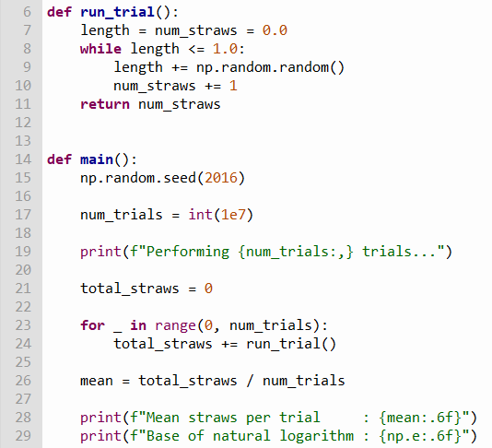
Open random_straws.py
⑥
⑦
⑧
①
②
③
④
⑤
⑨
⑩

Slide 19
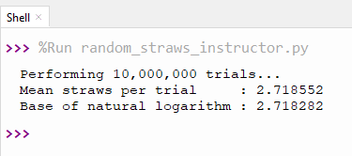
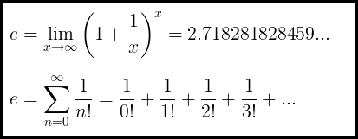
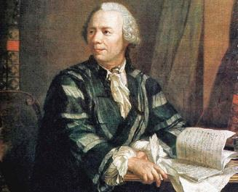
Run random_straws.py
This will take about 60 secs
Leonhard Euler
(1707 – 1783)

Slide 20
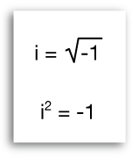
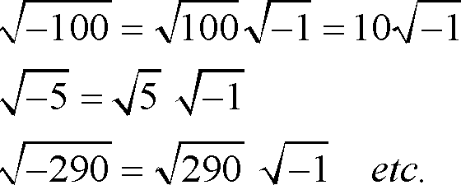
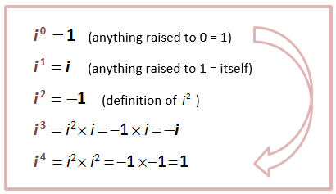
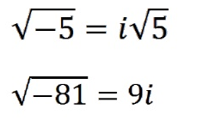
Complex Numbers

Slide 21
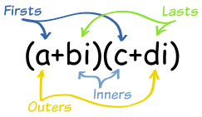

Complex Algebra
Sum:
$$\left(4+3i\right)+\left(5−4i\right)=\left(4+5\right)+\left(3−4\right)i$$
$$=9−i$$
Difference:
$$\left(4+3i\right)−\left(5−4i\right)=\left(4−5\right)+\left(3−\left(−4\right)\right)i$$
$$=−1+7i$$
Product:
$$\left(4+3i\right)\left(5−4i\right)=20−16i+15i−12i^{2}$$
$$=20−i+12$$
$$=32−i$$

Slide 22
Complex Algebra
Division:
$$\frac{\left(4+3i\right)}{\left(5−4i\right)}$$
$$\frac{\left(4+3i\right)}{\left(5−4i\right)}=\frac{\left(4+3i\right)}{\left(5−4i\right)}×\frac{\left(5+4i\right)}{\left(5+4i\right)}=\frac{\left(8+31i\right)}{41}$$
Complex Conjugate
$$=\frac{8}{41}+\frac{31}{41}i$$

Slide 23
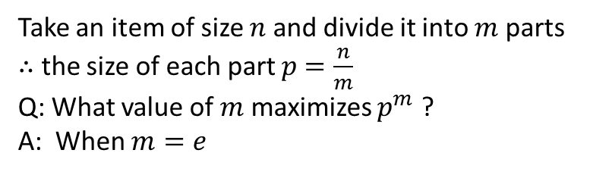

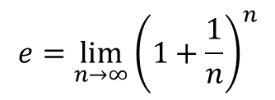
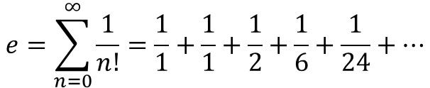
Why is $e$ so special?
Take an item of size $n$ and divide it into $m$ parts
$∴$ the size of each part $p$ $=\frac{n}{m}$
Q: What value of $m$ maximizes $p^{m}$ ?
A: When $m=e$
$$e=\sum_{n=0}^{∞}{\frac{1}{n!}=\frac{1}{1}+\frac{1}{1}+\frac{1}{2}+\frac{1}{6}+\frac{1}{24}+…}$$
$$e=\lim_{n→∞}{{\left(1+\frac{1}{n}\right)}^{n}}$$
$e$ is the base of the natural logarithm
= 2.718281828459045…
$$\int_{1}^{e}{\frac{1}{t}ⅆt=1}$$
$$\ln{e}=1$$

Slide 24
Why is $e$ so special?
$c≡$ a constant
$${ce}^{x}=c+cx+\frac{cx^{2}}{2!}+\frac{cx^{3}}{3!}+\frac{cx^{4}}{4!}+\frac{cx^{5}}{5!}+\frac{cx^{6}}{6!}+\frac{cx^{7}}{7!}+…$$
$\frac{d}{dx}\left(ce^{x}\right)=\frac{d}{dx}\left(c\right)+\frac{d}{dx}\left(cx\right)+\frac{d}{dx}\left(\frac{{cx}^{2}}{2!}\right)+\frac{d}{dx}\left(\frac{{cx}^{3}}{3!}\right)+…$
$$\frac{d}{dx}\left({ce}^{x}\right)=0+c+cx+\frac{cx^{2}}{2!}+\frac{x^{3}}{3!}+\frac{x^{4}}{4!}+\frac{x^{5}}{5!}+\frac{x^{6}}{6!}+\frac{x^{7}}{7!}+…$$
$$\frac{d}{dx}\left(ce^{x}\right)={ce}^{x}$$
${ce}^{x}$is the only function which is the derivative of itself !

Slide 25
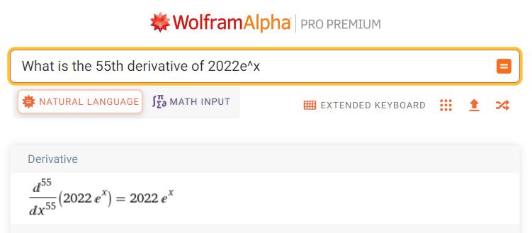



Why is $e$ so special?
$c≡$ a constant
$$\frac{d}{dx}\left(ce^{x}\right)={ce}^{x}$$
${ce}^{x}$is the only function which is the derivative of itself !

Slide 26
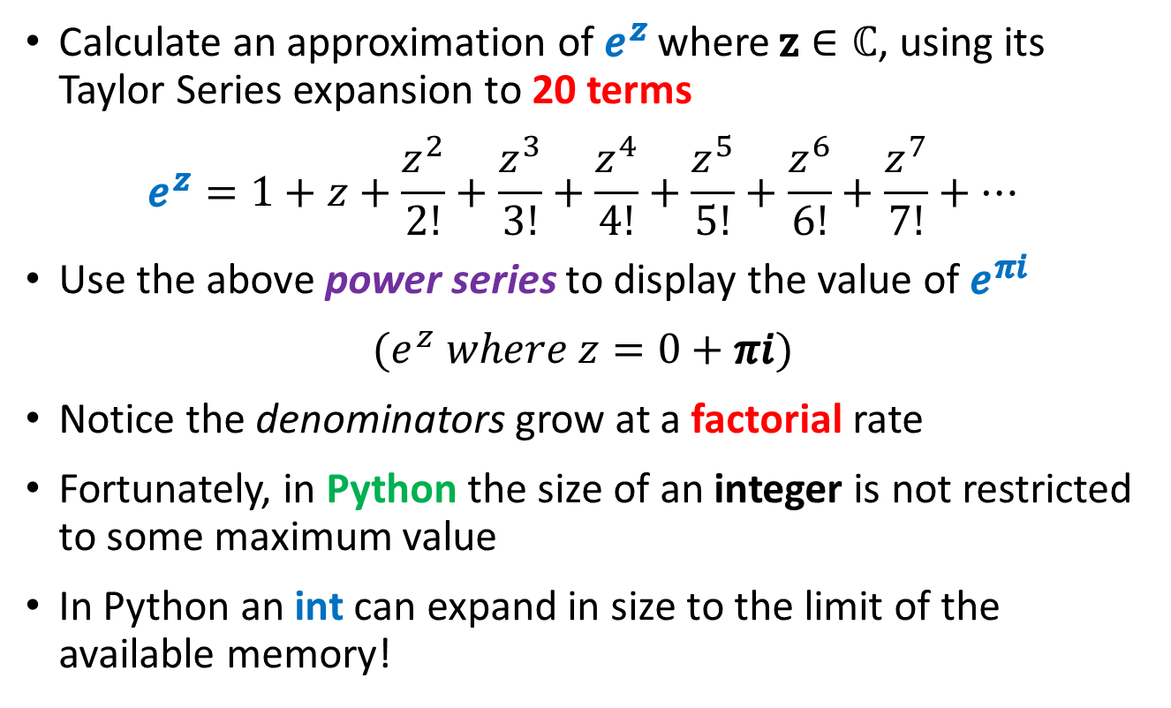
Euler’s Identity
Calculate an approximation of $e^{z}$ where $z∈ℂ$, using its Taylor Series expansion to 20 terms
$$e^{z}=1+z+\frac{z^{2}}{2!}+\frac{z^{3}}{3!}+\frac{z^{4}}{4!}+\frac{z^{5}}{5!}+\frac{z^{6}}{6!}+\frac{z^{7}}{7!}+…$$
Use the above power series to display the value of $e^{πi}$
$$(e^{z} where z=0+πi)$$
Notice the denominators grow at a factorial rate
Fortunately, in Python the size of an integer is not restricted to some maximum value
In Python an int can expand in size to the limit of the available memory!

Slide 27
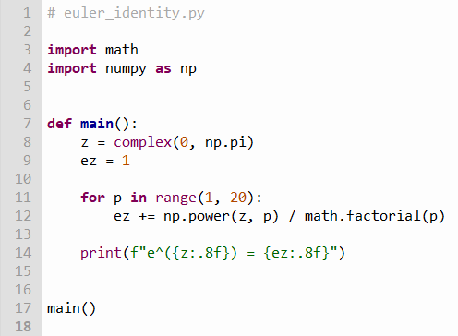
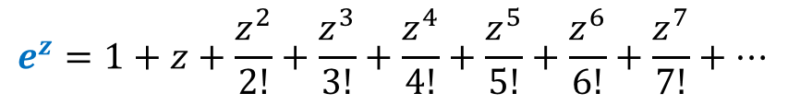
Edit euler_identity.py
①
②
③
④
⑤

Slide 28
Edit euler_identity.py
Type this code into your Thonny IDE

Slide 29
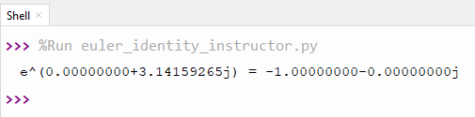
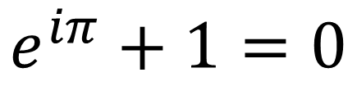
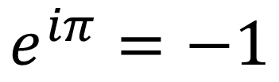
Run euler_identity.py
$$e^{iπ}=−1$$
$$e^{iπ}+1=0$$
Leonhard Euler
(1707 – 1783)

Slide 30
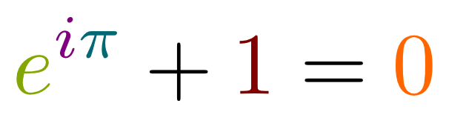
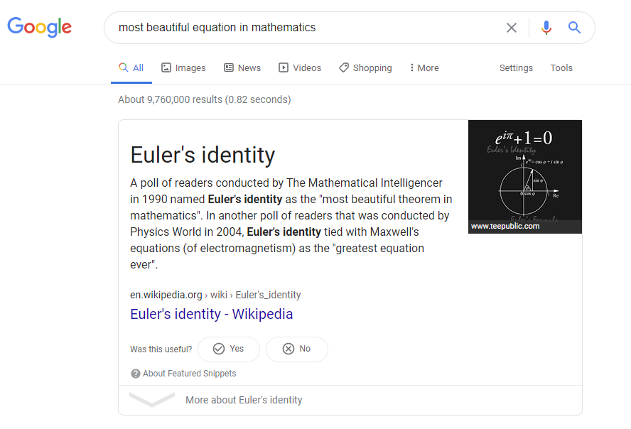
Euler’s Identity

Slide 31
$$−1=e^{πi}$$
$$i^{i}= ?$$
$${\left(−1\right)}^{\frac{1}{2}}={\left(e^{πi}\right)}^{\frac{1}{2}}$$
$$\sqrt{−1}=e^{\frac{πi}{2}}$$
$${\left(a^{b}\right)}^{c}=a^{bc}$$
$${\left(2^{3}\right)}^{4}=2^{3×4}=2^{12}$$
$$i=e^{\frac{πi}{2}}$$
$$i^{i}={\left(e^{\frac{πi}{2}}\right)}^{i}$$
$$e^{πi}=−1$$
$$i^{i}=e^{\frac{πi^{2}}{2}}$$
$$i^{i}=e^{\frac{−π}{2}}$$
$i^{i}≅0.20787∈ℝ$

Slide 32
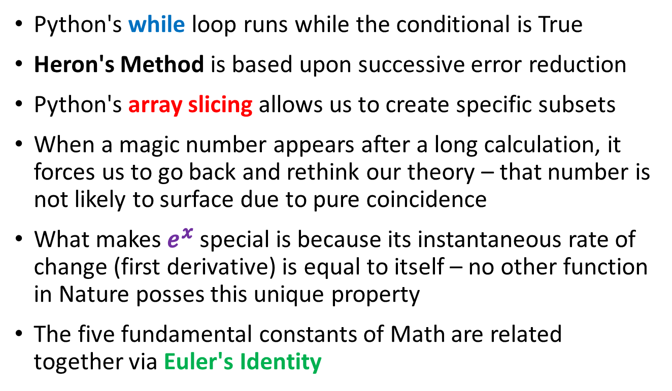
Session 04 – Now You Know…
Python's while loop runs while the conditional is True
Heron's Method is based upon successive error reduction
Python's array slicing allows us to create specific subsets
When a magic number appears after a long calculation, it forces us to go back and rethink our theory – that number is not likely to surface due to pure coincidence
What makes $e^{x}$ special is because its instantaneous rate of change (first derivative) is equal to itself – no other function in Nature posses this unique property
The five fundamental constants of Math are related together via Euler's Identity

Slide 33
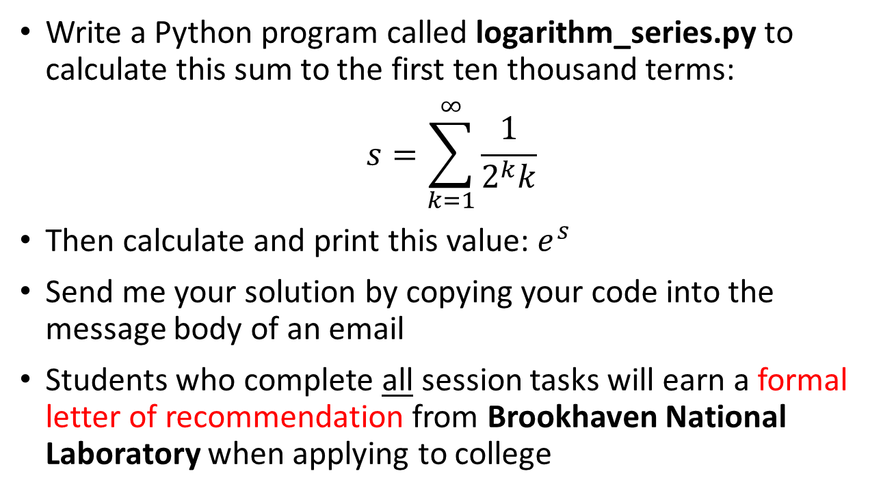
Task 04
Write a Python program called logarithm_series.py to calculate this sum to the first ten thousand terms:
$$s=\sum_{k=1}^{∞}{\frac{1}{2^{k}k}}$$
Then calculate and print this value: $e^{s}$
Send me your solution by copying your code into the message body of an email
Students who complete all session tasks will earn a formal letter of recommendation from Brookhaven National Laboratory when applying to college

